Slide 1

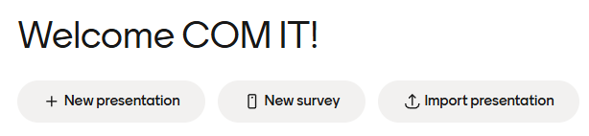
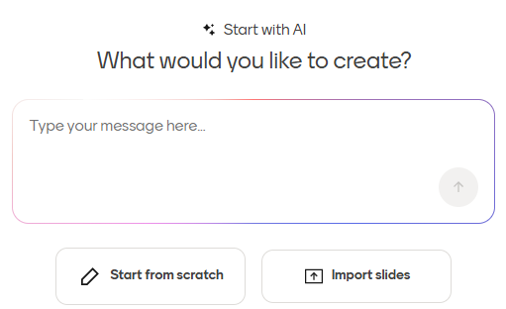
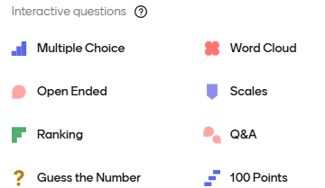
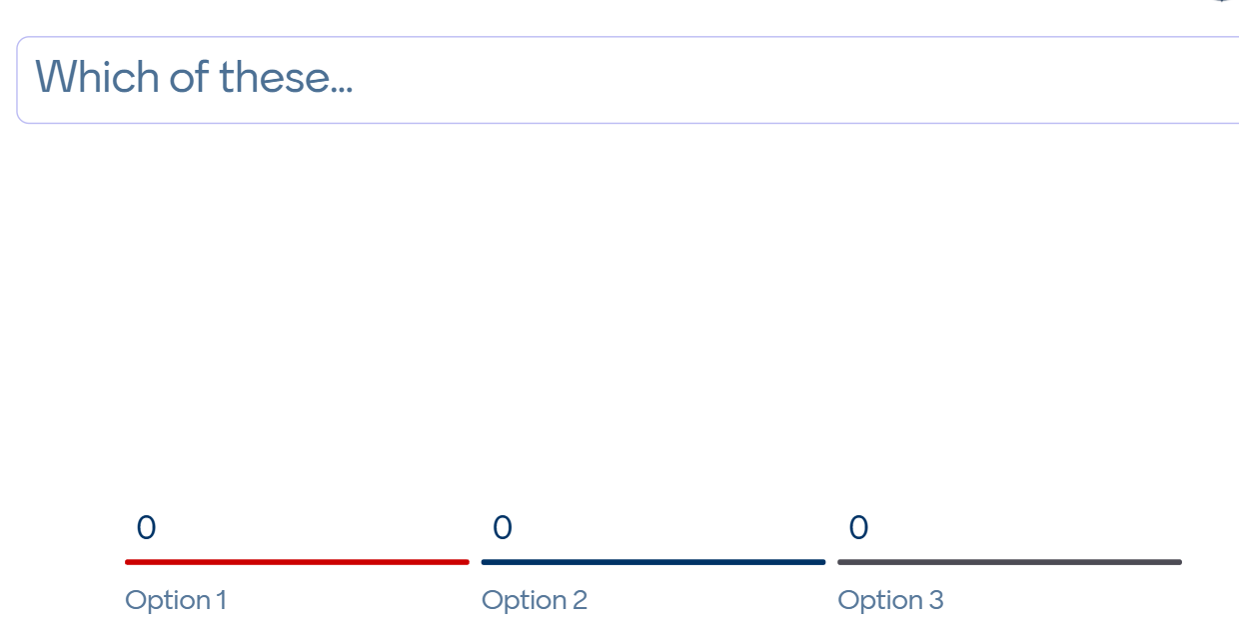


One-Page Mentimeter Quick Guide for Year 3 Lecturing Faculty
Step 1: On the Computer, follow the prompts to create a free Mentimeter account. https://www.mentimeter.com/auth/signup
(if prompted to join a workspace, please skip step)
Step 2: Once logged in, select
"New Survey"
(NOTE: Do not select presentation)
Step 3: Click “Start from Scratch”
Step 4: Choose a question type
Step 5: Enter your question and answer choices
Add as many questions (slides) as you’d like
  Click to add more questions
Click to edit question
Click to edit answer choices
Step 6: Name your poll: Your Name-Date of Lecture
Type in the text box
Then hit enter
This helps us to quickly identify your poll
Continued on the next page

Slide 2

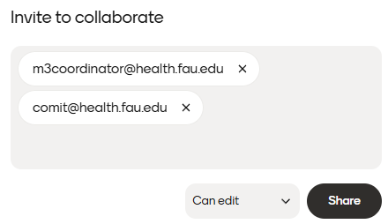
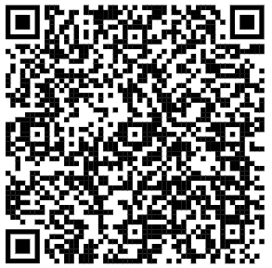
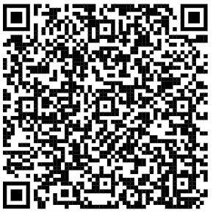
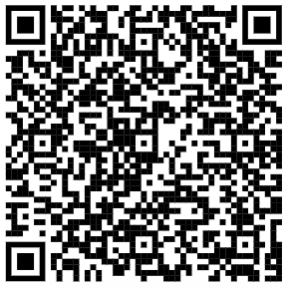
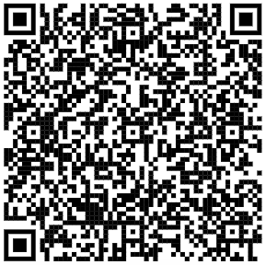
One-Page Mentimeter Quick Guide for Year 3 Lecturing Faculty
Step 7: Share your poll
Add comit@health.fau.edu and m3coordinator@health.fau.edu as Collaborators
Select “Can edit”
Then “Share”
Step 8: Submit a Help Desk ticket to let us know when your poll is ready!
Email COMhelpdesk@health.fau.edu
Subject: Mentimeter Poll – Lecture Support
Include: Your name, Lecture date, confirmation your poll is shared
What We’ll Do for You
✔ Access your poll from our paid FAU COM Mentimeter account
✔ Pull it up and test it before class
✔ Have it ready to launch during your lecture
✔ Provide live support if needed
____________________________________________________________________
Want to learn more? Check out our Ed Tech resources below.
Create a Mentimeter Poll
What is Mentimeter?
Student View: Join a Poll
Book a virtual meeting with Ed Tech for Mentimeter support

